Slide 1
Chapter 2: Relational Algebra

Slide 2
Relational Algebra
A procedural language consisting of a set of operations that take one or two relations as input and produce a new relation as their result.
Six basic operators
select: σ
project: ∏
union: ∪
set difference: –
Cartesian product: x
rename: ρ

Slide 3
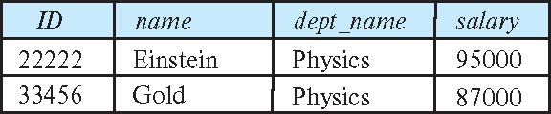
Select Operation
The select operation selects tuples that satisfy a given predicate.
Notation: σ _{p}(r)
p is called the selection predicate
Example: select those tuples of the instructor relation where the instructor is in the “Physics” department.
Instructor (ID, name, dept_name, salary)
Query
σ _{dept_name=“Physics”} (instructor)
Result:

Slide 4
Select Operation (Cont.)
We allow comparisons using
=, ≠, >, ≥. <. ≤
in the selection predicate.
We can combine several predicates into a larger predicate by using the connectives:
∧ (and), ∨ (or), ¬ (not)
Example: Find the instructors in Physics with a salary greater $90,000, we write:
σ _{dept_name=“Physics”} ∧ _{salary>90000} (instructor)

Slide 5
Project Operation
This operation shows the list of those attributes that we wish to appear in the result. Rest of the attributes are eliminated from the table.Notation:
∏ _{A1,A2,A3 ….Ak} (r)
where A₁, A₂ are attribute names and r is a relation name.
The result is defined as the relation of k columns obtained by erasing the columns that are not listed
Duplicate rows removed from result, since relations are sets

Slide 6
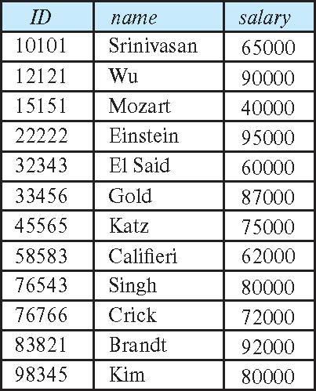
Project Operation (Cont.)
Example: eliminate the dept_name attribute of instructor
Query: ∏_{ID, name, salary} (instructor)
Result:

Slide 7
Composition of Relational Operations
The result of a relational-algebra operation is relation and therefore of relational-algebra operations can be composed together into a relational-algebra expression.
Consider the query -- Find the names of all instructors in the Physics department.
∏_{name}(σ _{dept_name} _{=“Physics”} (instructor))

Slide 8
Cartesian-Product Operation
The Cartesian product is used to combine each row in one table with each row in the other table. It is also known as a cross product
Instructor (ID, name, dept_name, salary)
Teaches(ID, courseID, section ID, semester, year)
Example: the Cartesian product of the relations instructor and teaches is written as:
instructor X teaches
Since the instructor ID appears in both relations we distinguish between these attribute by attaching to the attribute the name of the relation from which the attribute originally came.
instructor.ID
teaches.ID

Slide 9
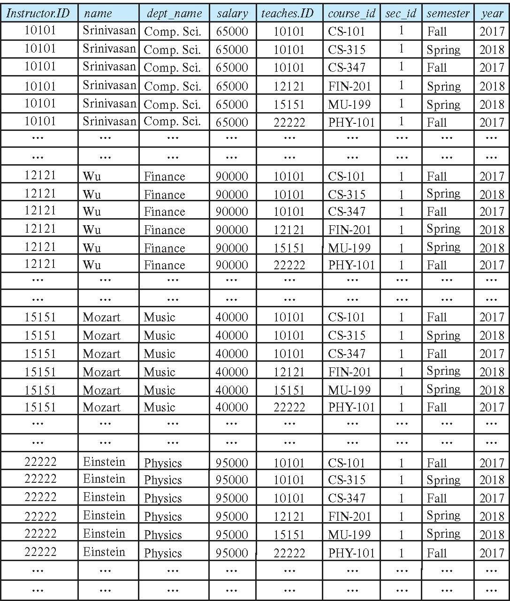
The instructor X teaches table

Slide 10
Join Operation
The Cartesian-Product
instructor X teaches
associates every tuple of instructor with every tuple of teaches
Most of the resulting rows have information about instructors who did NOT teach a particular course.
To get only those tuples of “instructor X teaches “ that pertain to instructors and the courses that they taught, we write:
σ _{instructor.id = teaches.id} (instructor x teaches ))
The result of this expression, shown in the next slide

Slide 11
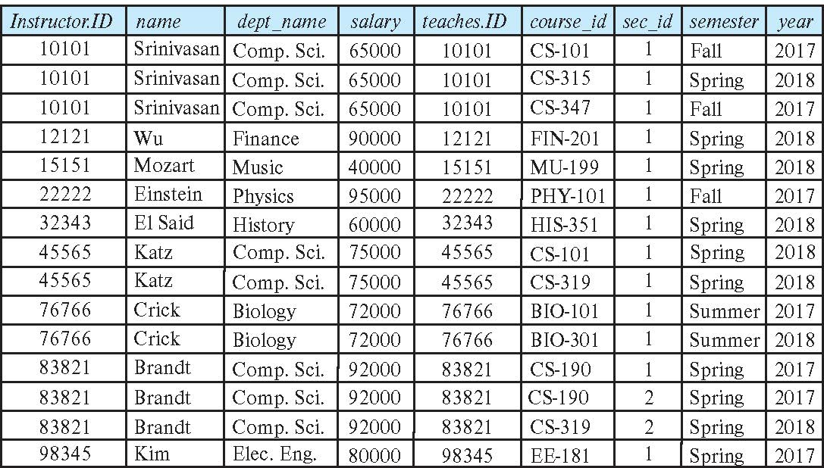
Join Operation (Cont.)
The table corresponding to:
σ _{instructor.id = teaches.id} (instructor x teaches))

Slide 12
Union Operation
The union operation allows us to combine two relations
Notation: r ∪ s
Example: to find all courses taught in the Fall 2017 semester, or in the Spring 2018 semester ∏_{course_id} (σ _{semester=“Fall” Λ year=2017} (section)) ∪ ∏_{course_id} (σ _{semester=“Spring” Λ year=2018} (section))

Slide 13
Set-Intersection Operation
The set-intersection operation allows us to find tuples that are in both the input relations.
Notation: r ∩ s
Example: Find the set of all courses taught in both the Fall 2017 and the Spring 2018 semesters.
∏_{course_id} (σ _{semester=“Fall” Λ year=2017} (section)) ∩ ∏_{course_id} (σ _{semester=“Spring” Λ year=2018} (section))

Slide 14
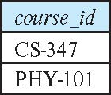
Set Difference Operation
The set-difference operation allows us to find tuples that are in one relation but are not in another.
Notation r – s
Example: to find all courses taught in the Fall 2017 semester, but not in the Spring 2018 semester ∏_{course_id} (σ _{semester=“Fall” Λ year=2017} (section)) − ∏_{course_id} (σ _{semester=“Spring” Λ year=2018} (section))

Slide 15
The Assignment Operation
It is convenient at times to write a relational-algebra expression by assigning parts of it to temporary relation variables.
The assignment operation is denoted by ← and works like assignment in a programming language.
Example: Find all instructor in the “Physics” and Music department. Physics ← σ _{dept_name=“Physics”} (instructor)
Music ← σ _{dept_name=“Music”} (instructor)
Physics ∪ Music
With the assignment operation, a query can be written as a sequential program consisting of a series of assignments followed by an expression whose value is displayed as the result of the query.

Slide 16
The Rename Operation
The results of relational-algebra expressions do not have a name that we can use to refer to them. The rename operator, ρ , is provided for that purpose
The expression:
ρ_{x} (E)
returns the result of expression E under the name x
To rename STUDENT relation to STUDENT1, we can use rename operator like:
If you want to create a relation STUDENT_NAMES with ROLL_NO and NAME from STUDENT, it can be done using rename operator as:
ρ(STUDENT1, STUDENT)
ρ(STUDENT_NAMES, ∏_{(ROLL_NO, NAME)}(STUDENT))

Slide 17
Equivalent Queries
There is more than one way to write a query in relational algebra.
Example: Find information about courses taught by instructors in the Physics department with salary greater than 90,000
Query 1
σ _{dept_name=“Physics”} ∧ _{salary > 90,000} (instructor)
Query 2
σ _{dept_name=“Physics”} (σ _{salary > 90.000} (instructor))
The two queries are not identical; they are, however, equivalent -- they give the same result on any database.

